Slide 1
Tableau
Training document
Aug 2013

Slide 2

The Business Intelligence Renaissance Christian Chabot, CEO & Co-founder
Tableau - MuCel
Mu Sigma

Slide 3
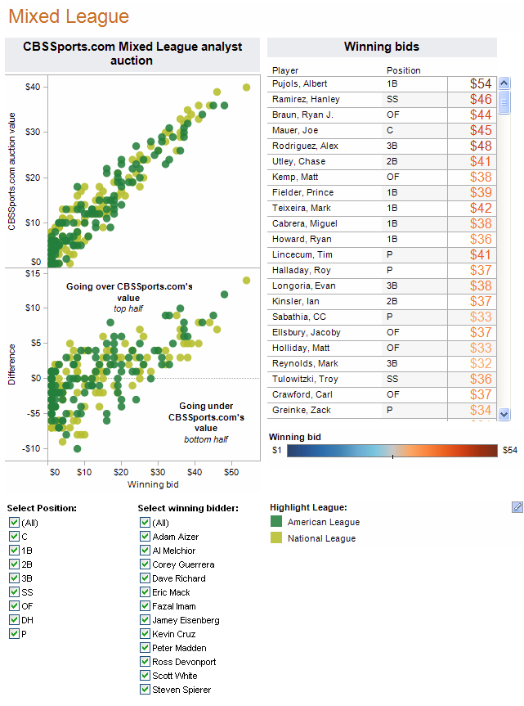
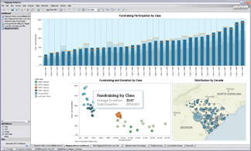
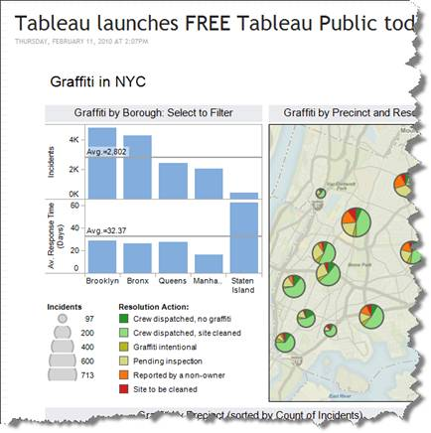
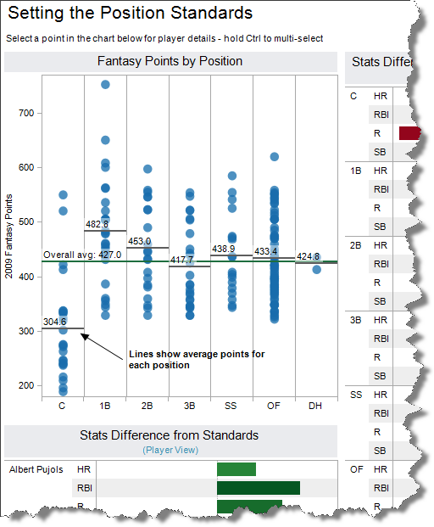
5 reasons why dashboards matter now

Slide 4
¹ Right Information to the Right Person
² Distributed Decision-Making
³ Drill-up, Drill-down and Drill-through
⁴ Domain Experts Build Analytics
⁵ Visual, Easy to Understand

Slide 5
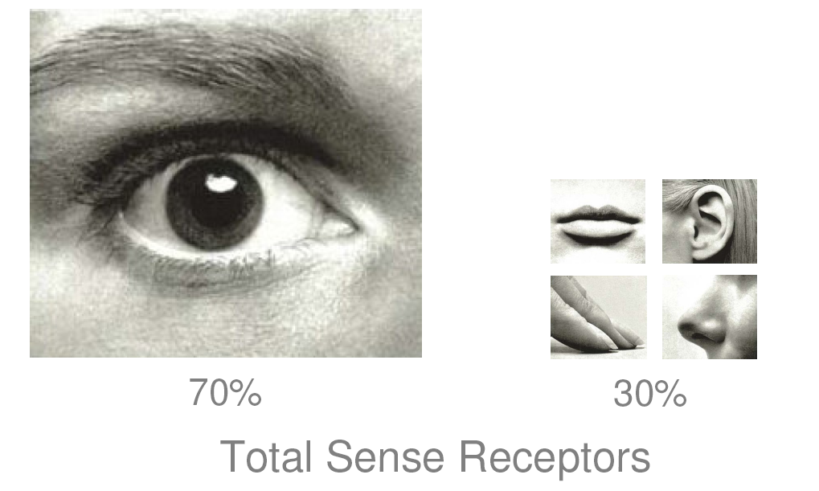
Vision: Most Powerful Perception Sense

Slide 6
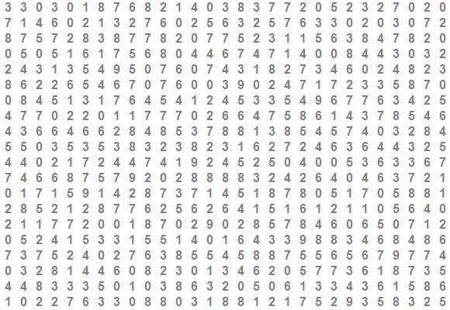
How many 9s in the grid below?

Slide 7
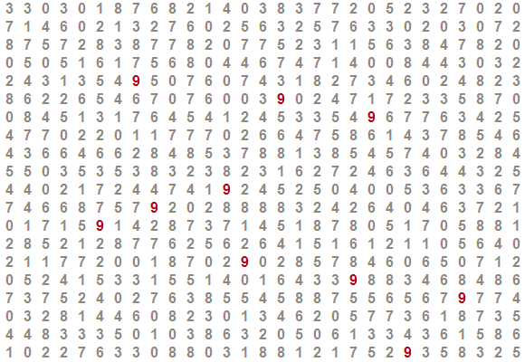
Is it easier to count now?

Slide 8
Tableau is a new-age self service BI tool, that aids in data analysis and creation of business dashboards
Introduction to Tableau
About the company
Tableau Software, Inc. was founded in 2003 and is headquartered in Seattle, U.S. It is a recognized leader in providing data visualization products, focused on business intelligence
Offerings
Tableau Desktop to create and publish workbooks Tableau Server to distribute the published workbooks with enterprise level scalability Tableau Public to create and quickly publish interactive visuals on the web Tableau Reader to view workbooks and dashboards only
Customers
Some of Tableau’s customers across various verticals include: BFSI - Allstate, Bank of America, Barclays, Citigroup Retail - Barnes & Noble, Starbucks Coffee, Wal-Mart Pharmaceutical - Merck, Pfizer, Sanofi Aventis Technology – eBay, EMC, Facebook
Key Differentiators
Tableau stands out because of the ease of usage and control it allows the users to manipulate the data Tableau can easily connect to a huge variety of data sources, ranging from excel sheets to delimited files, oracle databases and several more Interactive analysis can be shared with a report consumer equipped with a Web browser

Slide 9
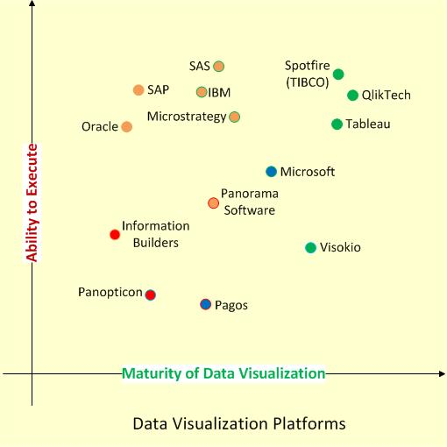
Tableau provides enhanced visualization capabilities, all the while maintaining its ease of usage
Comparison of BI tools
Source: http://apandre.wordpress.com/2011/02/14/q4dv/

Slide 10
Excerpts from Gartner B.I. platform survey on Tableau
Pros v/s Cons of Tableau
Strengths
Cautions
Overwhelmingly positive customer satisfaction in terms of ease of use, functionality, product quality, performance, support
Tableau delivers strong interactive visualization for analysis, dashboards, information delivery and managed analytic applications
Self contained BI platform which integrates with a large variety of data sources and drag-n-drop feature enable user engagement and customization
Tableau lacks broader BI platform capabilities, such as production reporting and predictive analytics
Tableau's products often fill an unmet need in organizations that already have a BI standard, and are frequently deployed as a complementary capability to an existing BI platform
Above average license price per user
Mu Sigma POV
Tableau enables the end user to move away from just a consumer to a creator of analytics
Mu Sigma POV
Individual license cost might be higher, but the cost of development is much lower
Source: Magic Quadrant for B.I. and Analytics Platforms - Feb. 2013

Slide 11
Tableau allows user to do an in-depth data analysis & visualization and create interactive dashboards with minimum effort
Tableau has three products to suit varying requirements
Tableau Desktop
Allows the user to connect to data , analyze them, then visualize and create interactive dashboards
The Software requires license which costs ~ $2000 (with life time free updates)
Tableau Reader
Allows the user to view at the data analysis, visualization and business intelligence information from Tableau packaged workbook
The Software does require any license and is free of cost
Tableau Server
Allows the user to upload the tableau workbook & data connections and share the link
Allows scheduling of periodic automatic refresh of the workbook with the latest data

Slide 12
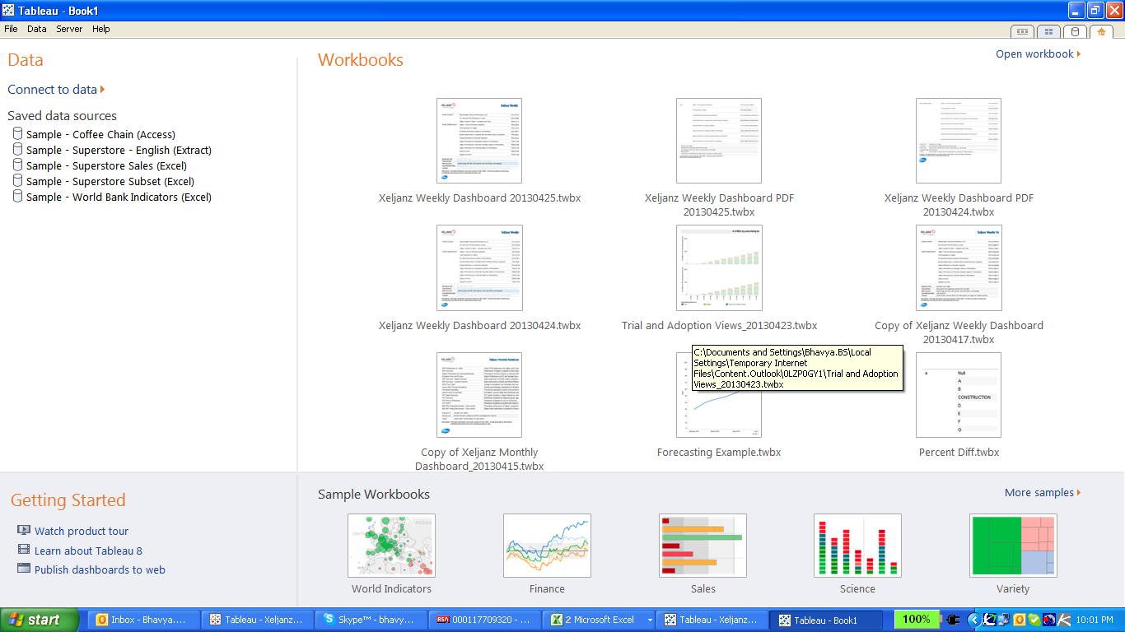
Tableau has four Tabs, icons of which can be found on the left top corner of Home Tab
Home : Has the set of recently opened workbooks, some samples workbooks and some saved data sources
Data Connection Tab : Provides a list of data connections that can be made, that includes connections from flat files as well connections to different servers
Thumbnail view : Provides the thumbnails of all the dashboards/sheets in the workbook
Sheet Tab : Shows a sheet/dashboard for working on it

Slide 13
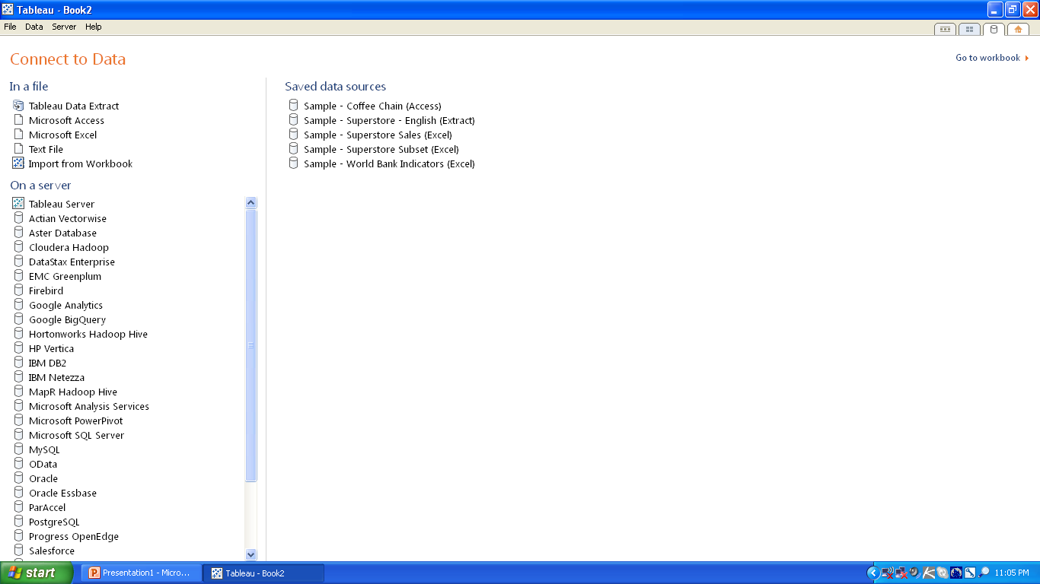
Data Connections in Tableau
Tableau provides a list of data connections, in the data connection tab, clicking from which data can be imported either from flat files or from server.
Import data from flat file
Import data from server

Slide 14
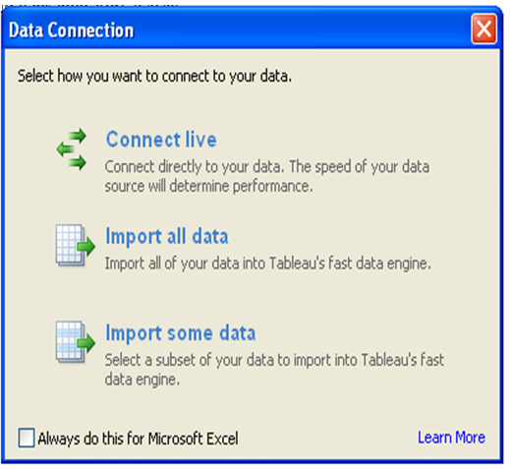
Different ways of connecting to the data
Directly connects to the data source and refers to it every time any field is used (generally used when the data is small)
Creates an extract of the data, which moves along with the packaged workbook (used when data is large)
Enables filtering of data over different fields before extracting it

Slide 15
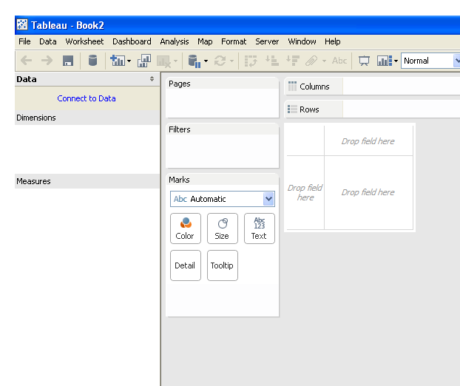
Basic view of a worksheet
Data Tab
Data consists of “Dimensions” and “Measures”.
Dimensions – All string and date variables fall under this category
Measures – All numeric fields on which calculations are formed, fall under this category.
Tableau automatically identifies the data types and groups them in dimensions and measures
Shelves
The different shelves present are
Rows – Contains the field that has to appear in rows
Columns – Contains the field that has to appear in columns
Filters – Contains the fields on which data has to be filtered. (Filters can be applied only for the current sheet/all sheets/specific sheets based on the requirement)
Pages – Fields in this shelf are not filtered but are restricted with respect to the view
Data Tab
Shelves

Slide 16
Basic view of a worksheet
Marks
The different options present under marks are
Drop down – This allows to choose the type of graph to be presented in the view
Color – The colors in the view will be based on the field pulled into this box
Size – The size of the representations in the view (bar, line etc.) can be adjusted based on the field pulled into this box
Text/Label – Any field pulled into this box, gives the label to the graph
Detail – The field pulled into this indicates the level of data for the sheet
Tooltip – Fields pulled into this, appears as tooltip (values appear when hovered over the graphs
Marks

Slide 17
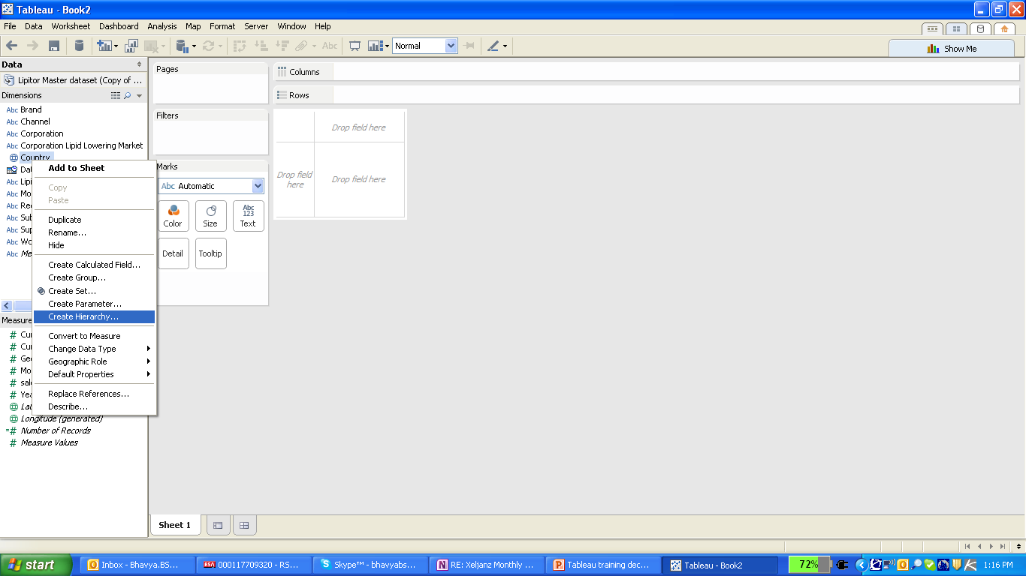
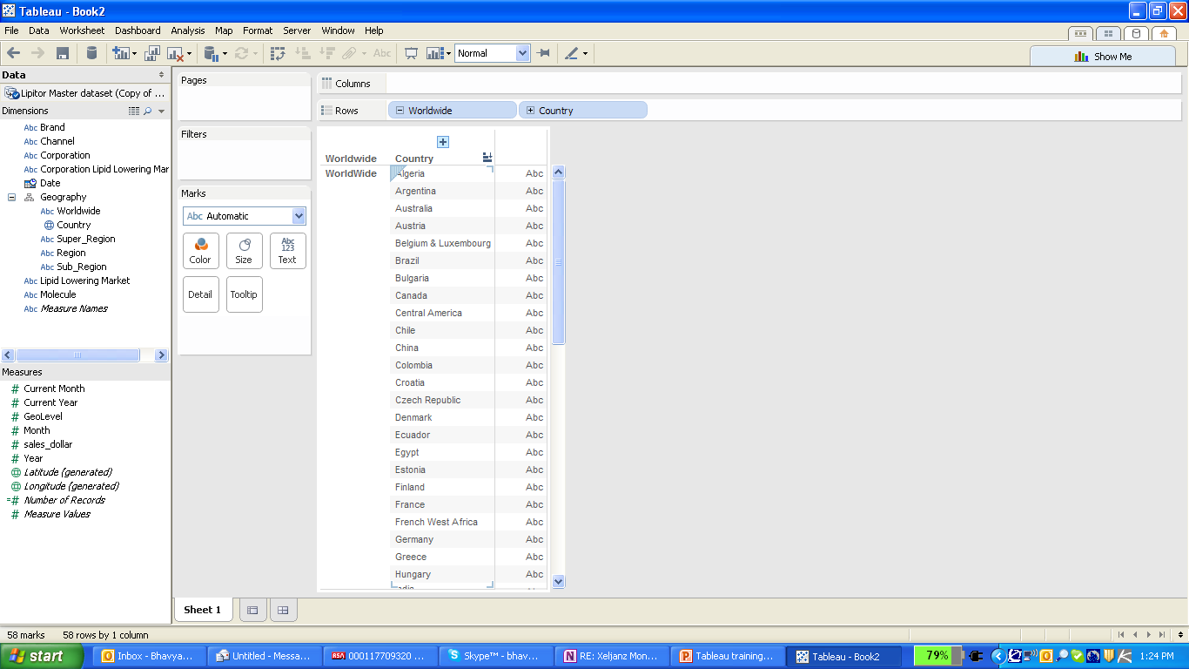
Hierarchy – This is used to group fields of decreasing levels in the form of a hierarchy
Once the hierarchy is created various fields can be pulled into it in the decreasing order of the hierarchy
Clicking on this “+” sign, helps to drill down to lowers levels of the hierarchy

Slide 18
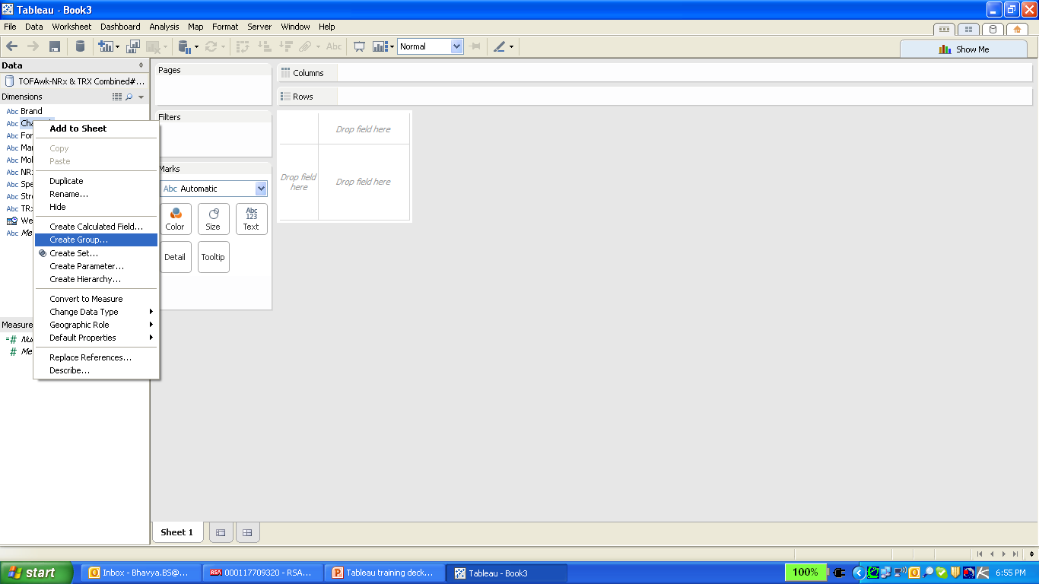
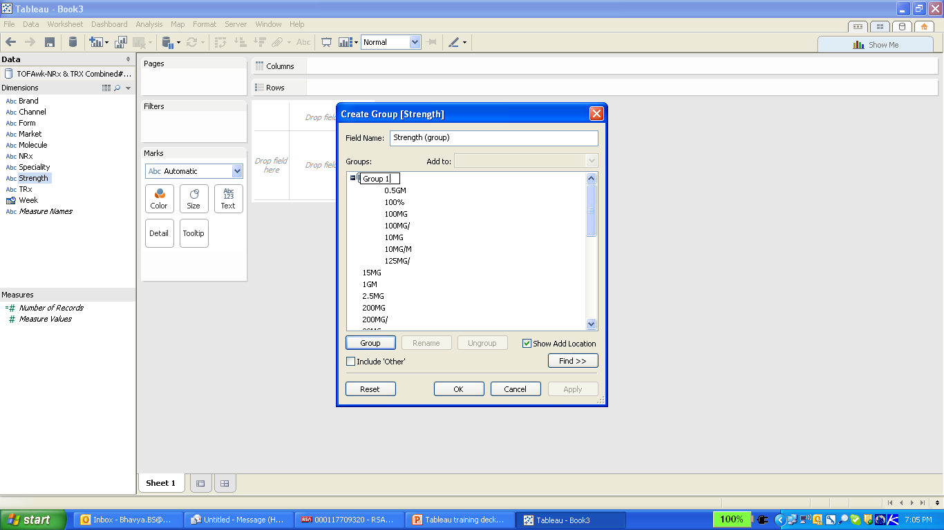
Groups – These are used to create groups among different rows of one field.
Many rows are pulled together into 1 group

Slide 19
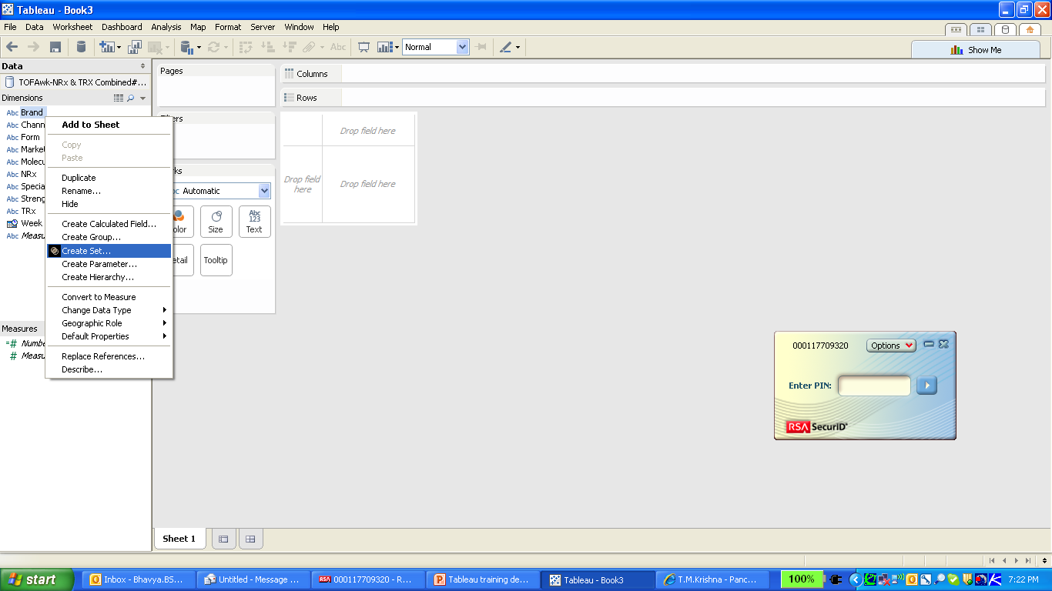
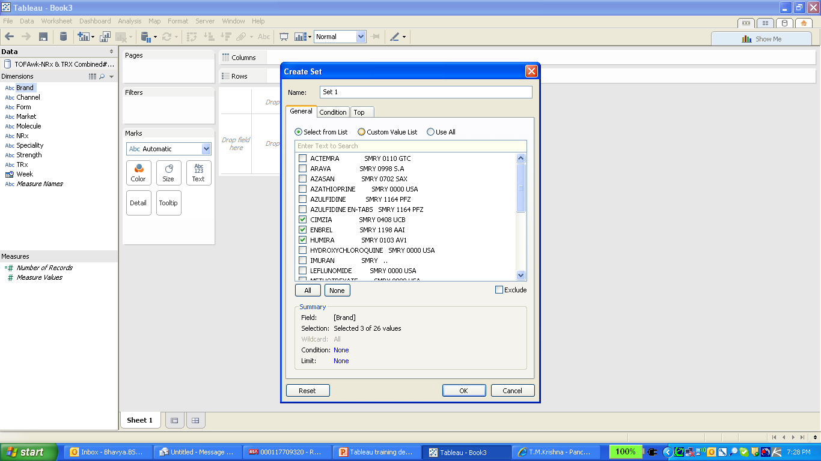
Sets – An easy way of adding a filter. Rows assigned to a set, filter the data accordingly when pulled into the sheet.
Sets can be defined, by manually selecting the required fields or by some condition or based on the top few rows

Slide 20
Filters
Filters can be used for limiting the data for analysis/visualization and can be applied on
Members of a dimension field
Range of values of a measure field
Relative dates / Range of dates of a Date field
By default, all filters are computed independently i.e., each filter accesses all rows the data source without regard to other filters.
A filter can be set a as context filter with add to context option. With setting a field as a context any other filters that are used act as dependent filters i.e., they process only the data that passes through the context filter.
Advantages of context filter :
Improve performance – If you set a lot of filters or have a large data source, the queries can be slow. You can set one or more context filters to improve performance.
Create a dependent numerical or top N filter – You can set a context filter to include only the data of interest, and then set a numerical or a top N filter

Slide 21
Calculated Fields and Aggregated Calculations
Tableau allows the user to create a new calculated field by defining a formula based on data source fields and other calculated fields, and using standard functions and operators
The new calculated field displays in either the Dimensions area or the Measures area of the Data window depending on the data type returned by the calculation
Calculated fields using aggregated functions like sum, max, min, avg, etc., are called aggregated calculations
An aggregated value cannot be combined with a disaggregated value. For example, SUM(Price)*[Items] is not valid while SUM(Price*Items) and SUM(Price)*SUM(Items) are both valid.
An aggregate calculation is always a measure and are always aggregated at “level of detail” which is defined by the fields placed in rows and detail shelf

Slide 22
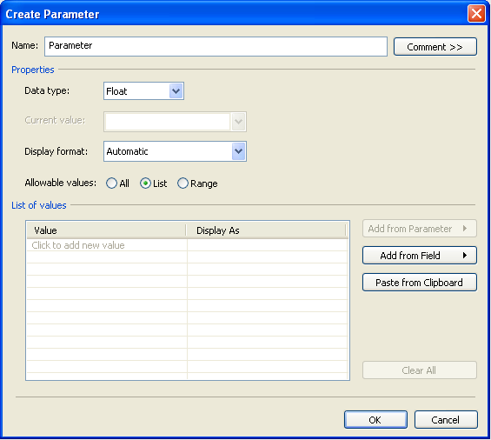
Parameters
Parameters are user defined variables that can be used to create a dynamic visualization
Since they are user defined, they wouldn’t have any connection with the data unless used in a calculated field, filter or reference lines.
Multiple value selection is not possible with parameters and the selections works globally across all sheets

Slide 23
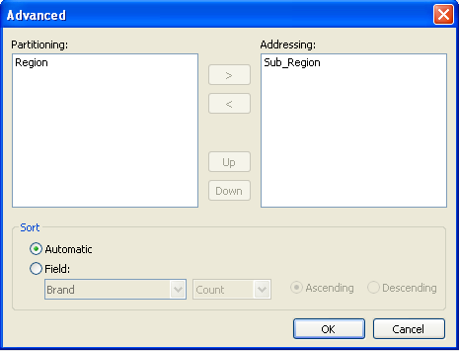
Table Calculations
Table Calculations allows the user to select the level of aggregation irrespective of fields in rows and detail shelves
Quick table calculations option allows the user to use few common table calculations like Running Total, Percent of Total, Moving Average etc., without having to define the calculation
The level of aggregation can be selected using the option – edit table calculation option
The calculations will be aggregated at the level of all fields included in ‘Partitioning’ box
All the fields included in the ‘Addressing’ box will be ignored will computing aggregations

Slide 24
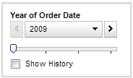
Pages
The Pages shelf allows to break a view into a series of pages
When a dimension is placed on the Page shelf, a new row is added for each member in the dimension.
When a measure is placed on the Pages shelf, the measure is converted into a discrete measure
User can manually advance through the sequence of pages in any of the following ways:
Use the drop-down menu to select a value.
Use the forward and back buttons on either side of the drop-down list to navigate through the pages one at a time.
Use the Page slider to quickly scroll forward and backward in the sequence of pages.
Selecting the ‘Show History’ option allows to show marks from previous pages in addition to marks for the current page

Slide 25
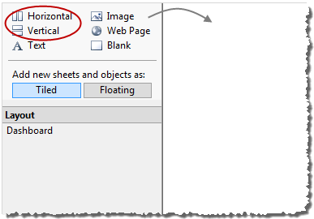
Dashboard
A dashboard is a collection of several worksheets and supporting information shown in a single place
A variety of supporting objects such as text areas, web pages, and images can also be added in a dashboard
All sheets and objects placed in the dashboard can be organized / arranged using containers
Horizontal Containers: Allows the user to place the sheets one beside the other
Vertical Containers: Allows the user to place the sheets one below the other

Slide 26
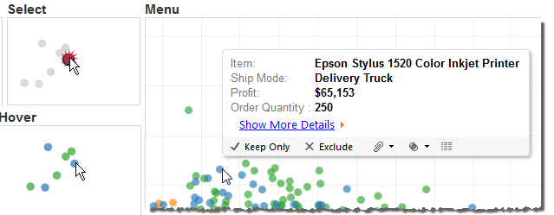
Actions
Tableau allows the user to add context and interactivity to your data using actions
There are three kinds of actions in Tableau:
Filter : Allows the user to use the data in one view to filter data in another
Highlight : Allows the user to use the data in one view to highlight the data in another
URL actions : It’s a hyperlink that points to a Web page, file, or other web-based resource outside of Tableau
Actions can be initiated by three following ways:
Hover - rest the pointer over a mark in the view to run the action. This option works well for highlight and filter actions within a dashboard.
Select - click on a mark in the view to run the action. This option works well for all types of actions.
Menu - right-click a selected mark in the view and then select an option on a the context menu. This option works well for filter and URL actions.

Slide 27
Best Practices : Structuring the dashboard
Place the most important view in the top or top left. Your eye is first drawn to upper left corner.
Make sure your most important data is on rows or columns
Have the views which are meant to be interacted with on the top
Use at most three views in a dashboard
Make sure that the legends and filters grouped or placed in an intuitive place. They are best viewed if positioned on the bottom or right hand side (Hint: top left is not usually ideal)
Avoid using multiple color schemes per dashboard. If you have to, then Multiple color schemes could be Purple-gray, Blue-red and Green-orange
In case of scatter, your most important data should be on rows or columns. Less important data should be in color, size, shape etc.
Always switch on color legend highlighting, so when someone clicks on a value in legend, the graph gets highlighted

Slide 28
Best Practices : Formatting
Axes/labels should have proper understandable names. (NOT “Value” or Sum(Apples))
Axes/labels should have a reasonable number of decimals (NOT 1.000000)
Make sure the mark labels make sense without an explanation
The Quick Filters is preferable with titles as commands (“Select a Team:”)
All sheets and documents must be named appropriately (NOT Sheet1, etc)
The title color should not clash with your color scheme used in the visualizations
As a general rule: axes and labels should be dark grey

Slide 29

what about specifics?

